Slide 1
Introduction to java

Slide 2
What is java

Slide 3
Java is a programming language and a platform.
Java is a high level, robust, secured and object-oriented programming language.
Platform: Any hardware or software environment in which a program runs, is known as a platform. Since Java has its own runtime environment (JRE) and API, it is called platform.
Where it is used?
According to Sun, 3 billion devices run java. There are many devices where java is currently used. Some of them are as follows:
Desktop Applications such as acrobat reader, media player, antivirus etc.
Web Applications internet application etc.
Enterprise Applications such as banking applications.
Mobile
Embedded System
Smart Card
Robotics
Games etc.

Slide 4
Types
Standalone Application
It is also known as desktop application or window-based application. An application that we need to install on every machine such as media player, antivirus etc. AWT and Swing are used in java for creating standalone applications.
Web Application
An application that runs on the server side and creates dynamic page, is called web application. Currently, servlet, jsp, struts, jsf etc. technologies are used for creating web applications in java.
Enterprise Application
An application that is distributed in nature, such as banking applications etc. It has the advantage of high level security, load balancing and clustering. In java, EJB is used for creating enterprise applications.
4) Mobile Application
An application that is created for mobile devices. Currently Android and Java ME are used for creating mobile applications.

Slide 5
What is the Java Programming Environment?
Java is a recently developed, concurrent, class-based, object-oriented programming and runtime environment, consisting of:
A programming language
An API specification
A virtual machine specification
Java has the following characteristics:

Slide 6
Object oriented - Java provides the basic object technology of C++ with some enhancements and some deletions.
Architecture neutral - Java source code is compiled into architecture-independent object code. The object code is interpreted by a Java Virtual Machine (JVM) on the target architecture.
Portable - Java implements additional portability standards. For example, ints are always 32-bit, 2's-complemented integers. User interfaces are built through an abstract window system that is readily implemented in Solaris and other operating environments.
Distributed - Java contains extensive TCP/IP networking facilities. Library routines support protocols such as HyperText Transfer Protocol (HTTP) and file transfer protocol (FTP).
Robust - Both the Java compiler and the Java interpreter provide extensive error checking. Java manages all dynamic memory, checks array bounds, and other exceptions.
Secure - Features of C and C++ that often result in illegal memory accesses are not in the Java language. The interpreter also applies several tests to the compiled code to check for illegal code.
After these tests, the compiled code causes no operand stack over- or underflows, performs no illegal data conversions, performs only legal object field accesses, and all opcode parameter types are verified as legal.
High performance - Compilation of programs to an architecture independent machine-like language, results in a small efficient interpreter of Java programs. The Java environment also compiles the Java bytecode into native machine code at runtime.
Multithreaded - Multithreading is built into the Java language. It can improve interactive performance by allowing operations, such as loading an image, to be performed while continuing to process user actions.
Dynamic - Java does not link invoked modules until runtime.
Simple - Java is similar to C++, but with most of the more complex features of C and C++ removed.

Slide 7
Java does not provide:
  Programmer-controlled dynamic memory
  Pointer arithmetic
  struct
  typedefs
  #define

Slide 8
JDK
JDK contains everything that will be required to develop and runJava application.
JRE (Java Run time Environment)
JRE contains everything required to run Java application which has already been compiled. It doesn’t contain the code library required to develop Java application.
JVM (Java Virtual Machine)
JVM is a virtual machine which work on top of your operating system to provide a recommended environment for your compiled Java code.
JVM only works with bytecode. Hence you need to compile your Java application(.java) so that it can be converted to bytecode format (also known as the .class file).
Which then will be used by JVM to run application.
JVM only provide the environment It needs the Java code library to run applications.

Slide 9
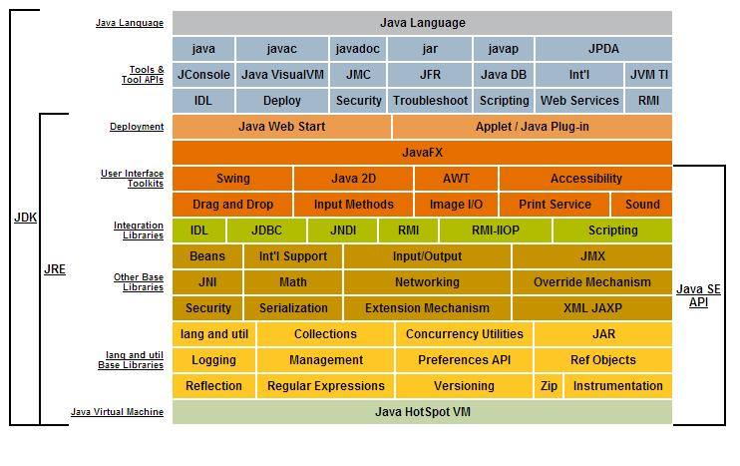
JDK vs JRE vs JVM

Slide 10
Now as per diagram you can identify what is the difference.
JRE = JVM + Required Library to run Application.
JDK = JRE + Required Library to develop Java Application.

Slide 11
Java Portability
In order to understand portability in Java you need to understand what happens to java code from start to finish.
1- Java Source Code (Written by Developer) (Machine Neutral)
2- Compiled Code / Byte Code (Compiled by javac) . (Machine Neutral)
3- Byte Code executed (Executed by JVM) (Machine Specific)
In step 2, javac (Java Compiler) converts Java code to byte code. This can be moved to any machine(Windows / Linux) and executed by JVM.
JVM reads the bytecode and generates machine specific code. In order to generate machine specific code JVM needs to be machine specific.
So every type of Machine(Windows / Linux / Mac) has a specific JVM. So in this way the coder doesn’t need to bother with generating byte code.
JVM takes care of portability. So the final answer is Java is Portable but JVM is Machine Specific.

